Slide 1
ON ECONOMIC, BUSINESS & POLITICAL CLIMATE Roger Tutterow, Ph.D. Coles College of Business Kennesaw State University rtuttero@kennesaw.edu Manufacture Alabama 2021 Annual Meeting September 17, 2021

Slide 2
Topic #1:
After 10 years of growth, COVID-19 sidelined the economy . . . But for how long . . . And what parts of the “new normal will be “new”?

Slide 3
Three Questions . . . that Dominated the Economics
What are the dynamics of the infection? Another surge? Can we get re-infected? Will COVID-19 mutate?
How do we separate the effects of voluntary behaviors
from government mandated behaviors?
How do we respond with government supports end?
What about end of forbearance agreements?

Slide 4
Contributions To GDP Growth
(Source: Bureau of Economic Analysis)
 | GDP = | Consumption | Gross Investment | Net Exports | Government
2019: Q3 | 2.80% | 2.12% | 0.22% | 0.07% | 0.36%
2019: Q4 | 1.90% | 1.13% | -1.18% | 1.43% | 0.52%
2020: Q1 | -5.10% | -4.79% | -0.92% | -0.05% | 0.63%
2020: Q2 | -31.20% | -24.10% | -9.64% | 1.53% | 0.97%
2020: Q3 | 33.80% | 25.51% | 11.71% | -3.25% | -0.19%
2020: Q4 | 4.50% | 2.26% | 4.01% | -1.65% | -0.09%
2021: Q1 | 6.30% | 7.44% | -0.37% | -1.56% | 0.77%
2021: Q2 | 6.60% | 7.80% | -0.67% | -0.24% | -0.33%
 | Gross Investment = | Nonresidential | Residential | Inventory
2019: Q3 | 0.22% | 0.40% | 0.14% | -0.32%
2019: Q4 | -1.18% | -0.23% | 0.04% | -0.99%
2020: Q1 | -0.92% | -1.14% | 0.73% | -0.51%
2020: Q2 | -9.64% | -4.28% | -1.36% | -4.01%
2020: Q3 | 11.71% | 2.72% | 2.16% | 6.84%
2020: Q4 | 4.01% | 1.57% | 1.34% | 1.10%
2021: Q1 | -0.37% | 1.65% | 0.60% | -2.62%
2021: Q2 | -0.67% | 1.21% | -0.58% | -1.30%

Slide 5
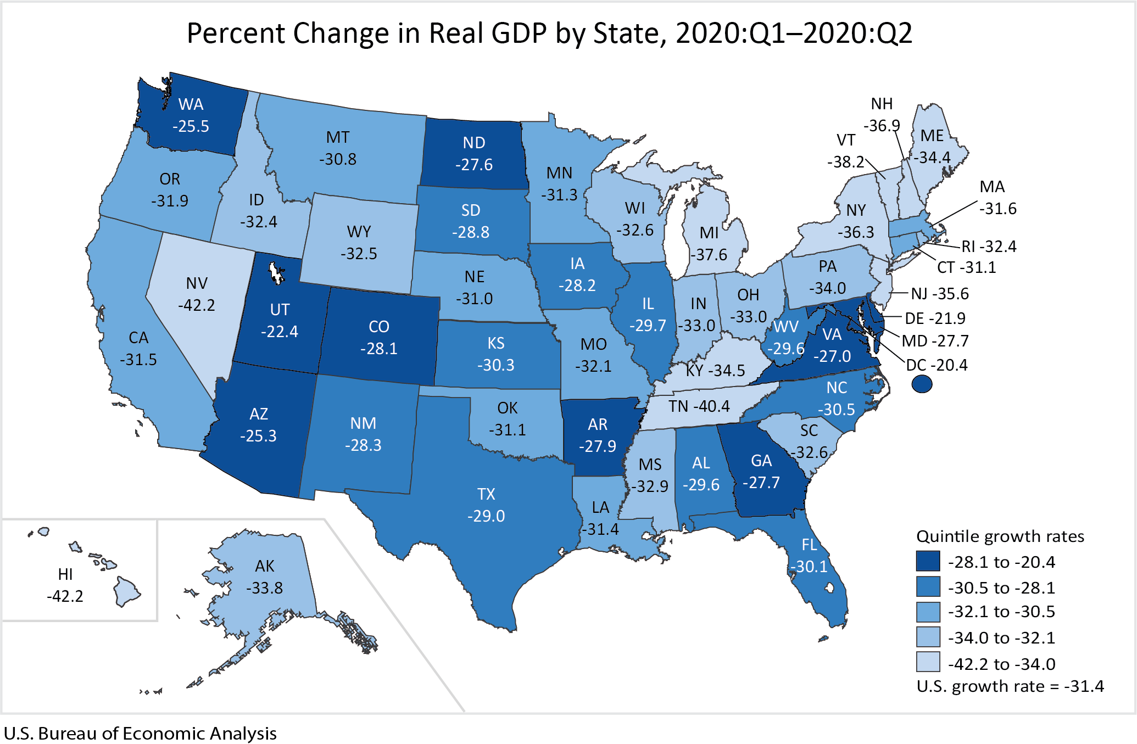
2Q GDP Growth: By State

Slide 6
ISM’s “PMI” (Source: Institute of Supply Management)

Slide 7
Industrial Production

Slide 8
Industrial Production: From Peak

Slide 9
Foreign Exchange: Dollar (Trade Weighted) (Source: Board of Governors of the Federal Reserve System)

Slide 10
Freight Shipments (Source: Cass Freight Index)

Slide 11
Consumer Sentiment (source: University of Michigan, Survey Research Center)

Slide 12
Retail Sales (source: U.S. Bureau of the Census, annual rate of growth)

Slide 13
Retail Sales (source: U.S. Bureau of the Census, annual rate of growth)

Slide 14
Inventory/Sales Ratio (Source: Department of Commerce, in months)

Slide 15
Inventory/Sales Ratio (Source: Department of Commerce, in months)

Slide 16
Inventory/Sales Ratio (Source: Department of Commerce, in months)

Slide 17
Leading Economic Indicators (source: Conference Board, % change in last 6 months)

Slide 18
Topic #2:
Labor market concerns were about availability – then unemployment – now, where are the workers

Slide 19
Change in Payroll Employment (Source: Bureau of Labor Statistics)

Slide 20
Change in Payroll Employment (Source: Bureau of Labor Statistics)

Slide 21
Employment Below Peak (Source: Bureau of Labor Statistics)

Slide 22
Drop from Peak (Source: Bureau of Labor Statistics)

Slide 23
Recover from Bottom (Source: Bureau of Labor Statistics)

Slide 24
Employment: Alabama (thru 2/20)

Slide 25
Employment: Alabama (thru 7/21)

Slide 26
US Employment by Sector (post-Covid) (Source: Bureau of Labor Statistics)

Slide 27
Employment (Source: Bureau of Labor Statistics)

Slide 28
Labor Force Participation

Slide 29
JOLTS: Job Openings

Slide 30
Topic #3:
Oil prices plunged, then surged. Okay, gas were cheaper – that was good for North Carolina but bad for Texas – but now what?
And what about wood . . . Brother, can you spare a 2x4?
. . . and, are the inflation worries on the table to stay?

Slide 31
Prices: Still talk of Deflation/Inflation? (source: Bureau of Labor Statistics)
CPI was up 0.5% in July – after being up 0.9% and 0.6% in June and May.
Core CPI up 0.3% in July – after being up by 0.9% and 0.7% in June and May.
Overall CPI up 5.4% over last 12 months. Core up 4.3% over same period.
Supply chain disruptions, hoarder behavior was at play in food prices in early 2020, easing in recent months.
Energy component up by 23.8% over the last 12 months.

Slide 32
CPI & PCE: Core (source: US Department of Labor)

Slide 33
Inflation Transitory?
Supply Shocks vs Demand Shocks
Productivity & Unit Labor Cost
Globalization & Value of $
Labor Shortages & Age Demographics
Capacity Utilization

Slide 34
Crude Oil: West Texas Intermediate (Source: US Energy Information Administration)

Slide 35
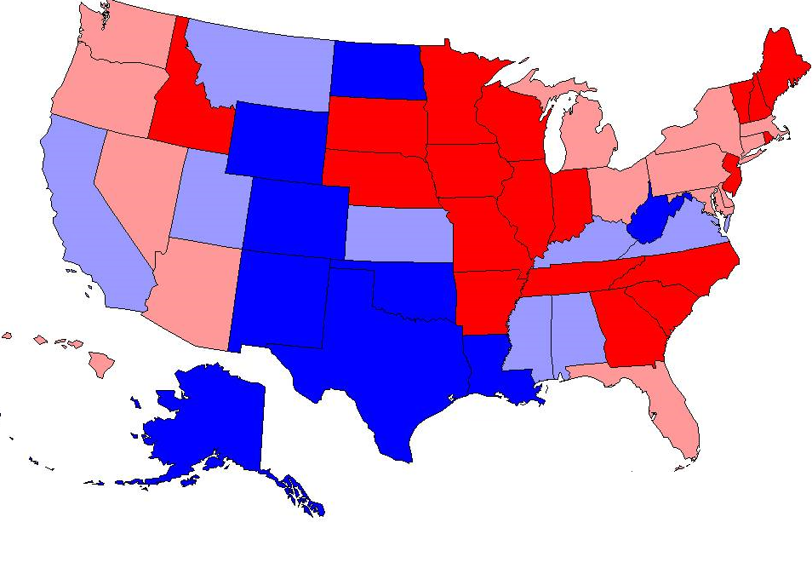
Who Gets Hurt By Lower Energy Prices?

Slide 36
Construction Cost w/o Energy (Source: BLS PPI & ABC)

Slide 37
Topic #4:
After starting to unwind three rounds of QE . . . we went to zero in March 2020.
. . . sowhat the banks – and the alphabet soup of liquidity facilities?

Slide 38
Federal Funds Rate 9 Up, 3 Down, back to ZLB (Source: Board of Governors of Federal Reserve System)

Slide 39
10-Year Treasury Bonds (Source: Board of Governors of Federal Reserve System)

Slide 40
Federal Reserve Stimulus
March 15
FFR to ZLB
Quantitative Easing
Incent Discount Window
Relax Capital Requirements (Buffers)
Extend U.S. Dollar Liquidity Swaps
March 17
CPFF (Commercial Paper)
PDCF (Primary Dealers)
March 18
MMLF (Money Market Mutual Funds)
March 23
QE expanded to CMBS
PMCCF/CMMCCF (Corporate Credit)
TALF (Term Asset-Based Securities)
Backed by Treasury Funds
April 9
PPP Loans
Main Street Business Debt (1 yr def)
Municipal Liquidity (pop > 1MM)

Slide 41
Fed: Securities Held Outright (source: Board of Governors, Federal Reserve System)

Slide 42
90+ Days Delinquent by Loan Type (source: Federal Reserve Bank of New York Credit Panel/Equifax)
Percent
Percent
15
15
Credit Card
Student Loan
10
10
Auto Loan
5
Mortgage
5
HE Revolving
0
0

Slide 43
MBA Mortgage Activity: Purchase & Refinance (Source: Mortgage Bankers Association)

Slide 44
90+ Days Delinquent by Loan Type (source: Federal Reserve Bank of New York Credit Panel/Equifax)
Percent
Percent
15
15
Credit Card
Student Loan
10
10
Auto Loan
Mortgage
5
5
HE Revolving
0
0

Slide 45
CRE Loan Standards: Net Tightening (Source: Federal Reserve System, Senior Officers Lending Survey)

Slide 46
C&I Loan Standards: Net Tightening (Source: Federal Reserve System, Senior Officers Lending Survey)

Slide 47
Topic #5:
Residential and commercial real estate moving in different directions??
Housing market getting “frothy” again?

Slide 48
Construction Spending (Source: U.S. Bureau of Census)

Slide 49
Architecture Billings Index (AIA)

Slide 50
Non-Residential Construction (Source: U.S. Bureau of Census)

Slide 51
US Housing Permits: SF and Total (source: U.S. Bureau of Census)

Slide 52
US Housing Permits: Multi-family (Source: U.S. Bureau of Census)

Slide 53
Case Shiller: National Index (source: Standard & Poor’s)

Slide 54
Home Price per $000 P&I

Slide 55
CS/S&P Home Price Index (Source: S&P Case Shiller)

Slide 56
Home Prices: Alabama

Slide 57
Household RE Equity (Source: Board of Governors of Federal Reserve System)

Slide 58
Topic #6:
COVID-19 opened the flow on spending – where do we go from here?
How will be pay for it?
And what about the demographics?

Slide 59
Currents Issues in Fiscal Affairs
Federal:
Fiscal Outlook fundamentally shifted back by COVID
Next in Play: Infrastructure, FAST extended, Tax Changes: Rates & SALT
Always in Play: SCOTUS
Ongoing Play: Revising Trade – China deals on hold
Bilateral vs Multilateral, Lumber deals and tariffs
States:
Income and Sales Tax revenue plunge; spending cut will follow
Some State Revenues in Surplus
Deferred Income Tax collection shifts state revenues
Tax Reform Initiatives in other States slow, but SALT consideration weigh in
SE states domination biz location ranking, but not exclusive.
Local:
RE valuation rising = tax revenues, fiscal distress moderating
Federal bailout of Munis with over 1MM in population
The ZOOM Economy!!

Slide 60
Debt as % of GDP (source: U.S. Office of Management & Budget)

Slide 61
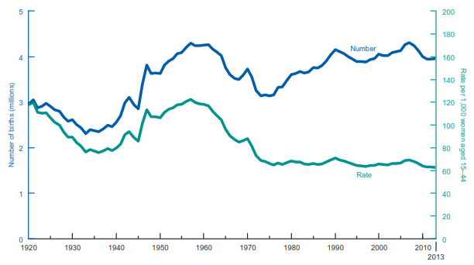
The Demographics: Boom & Bust (Source: CDC, US Bureau of Census)

Slide 62
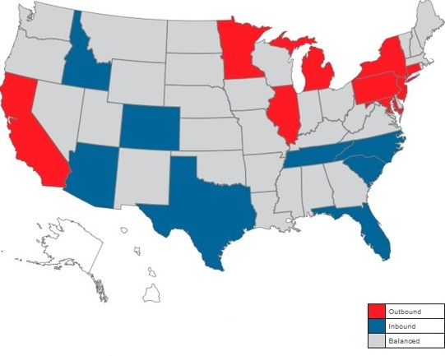
2020 Migration (source: NAMS Report)

Slide 63
ON ECONOMIC, BUSINESS & POLITICAL CLIMATE Roger Tutterow, Ph.D. Coles College of Business Kennesaw State University rtuttero@kennesaw.edu Manufacture Alabama 2021 Annual Meeting September 17, 2021

