Slide 1
TRUCKING

Slide 2
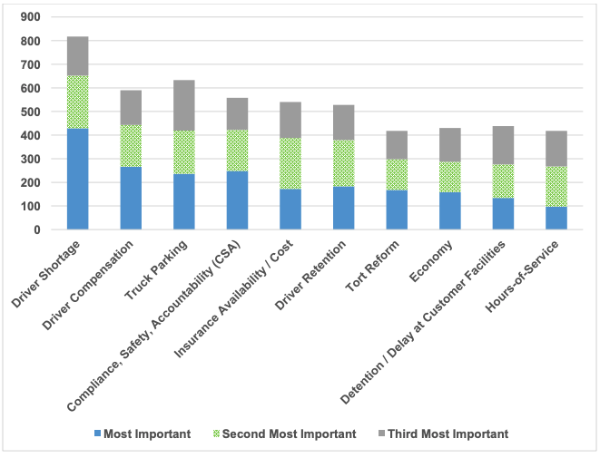

Driver Shortage
  Age
  Salary vs Responsibility
  Public Perception
Insurance Cost
  18% increase over the last 5 years
  Nuclear Verdicts – 52% annual increase from 2010-2018
Congestion
  Customer Facilities
  Highways
  Ports

Slide 3
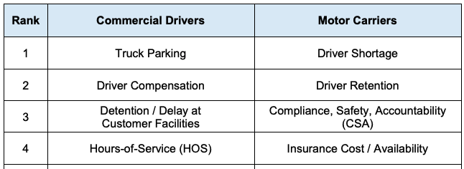
DRIVER v CARRIER

Slide 4
